Slide 2
Esspresso Freamwork for mobile automation tests Krzysztof Zając & Korneliusz Rembak

Slide 3


Mobile testing vs Web and Desktop Testing
Supported platforms and devices mean you have more combinations to test.
Adaptability and limited space mean screen size is changing constantly.
Complex user interaction means more than one way to do everything.
Application type – Web, Native or Hybrid.
Dependency on emulators and simulators.

Slide 4

Mobile testing vs Web and Desktop Testing
Dependency on networks and carriers means more variations in testing.
Rapid installations, removals, and updates mean staying on top of the latest apps.
Session management and interruptions.
Mobile-specific non-functional testing means there are many more dimensions to testing.

Slide 5
Testing mobile Apps

Slide 6
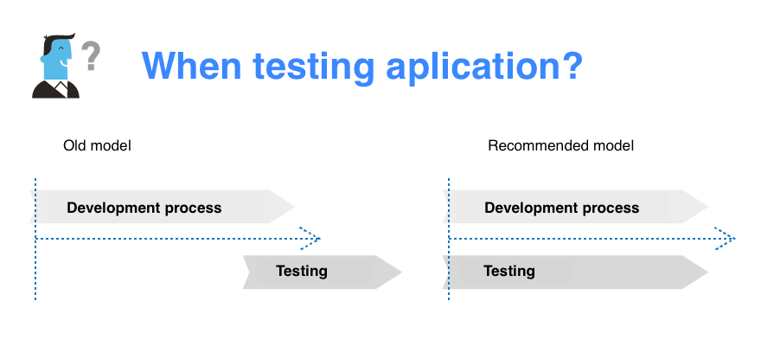
Continuous testing

Slide 7

Types of tests
Manual tests.
Unit tests.
Beta tests and automatic reporting.
Automatic tests.
Device farms.

Slide 8
Testing FRAMEWORKS

Slide 9
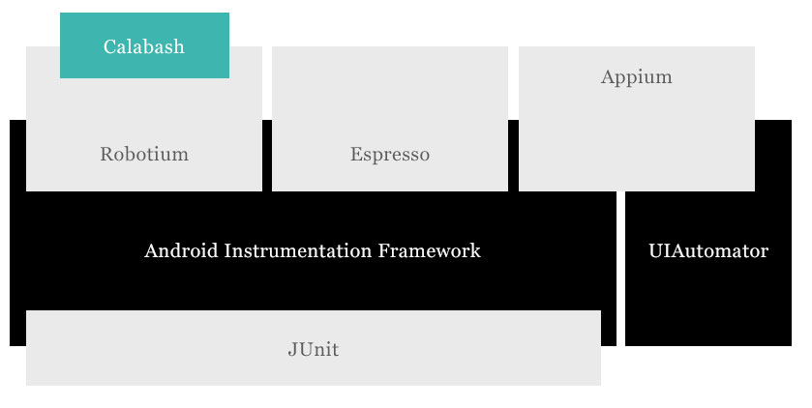
Testing tools

Slide 10
ESPRESSO

Slide 11
Espresso
Espresso is part of the Android Testing Support Library.
Easy to set up and compatible with Android code
Makes test more durable and reliable across platforms
No need to use waits/sleeps to synchronize UI and test code
Faster UI test
No need advance knowledge of the UI details needed to write tests

Slide 12
Testing in espresso
Find UI element which you want test
Interact with this element
Check the results after interacting

Slide 13
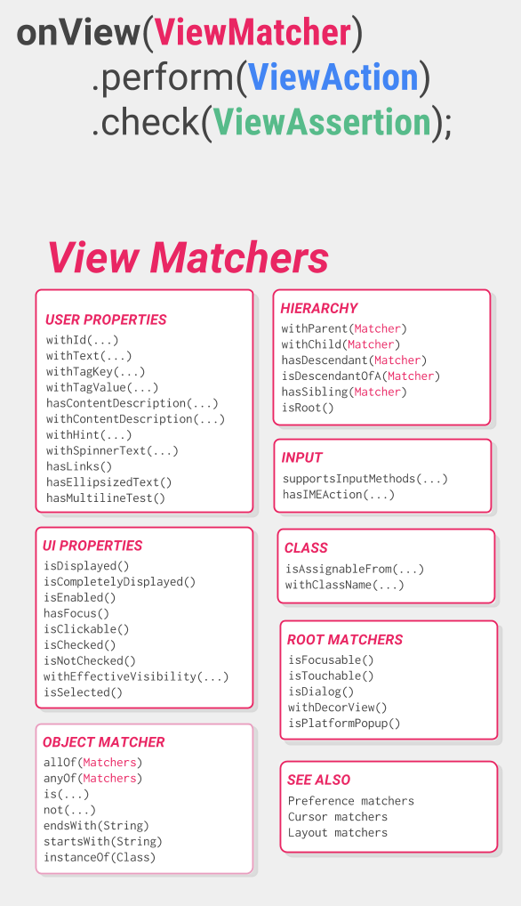
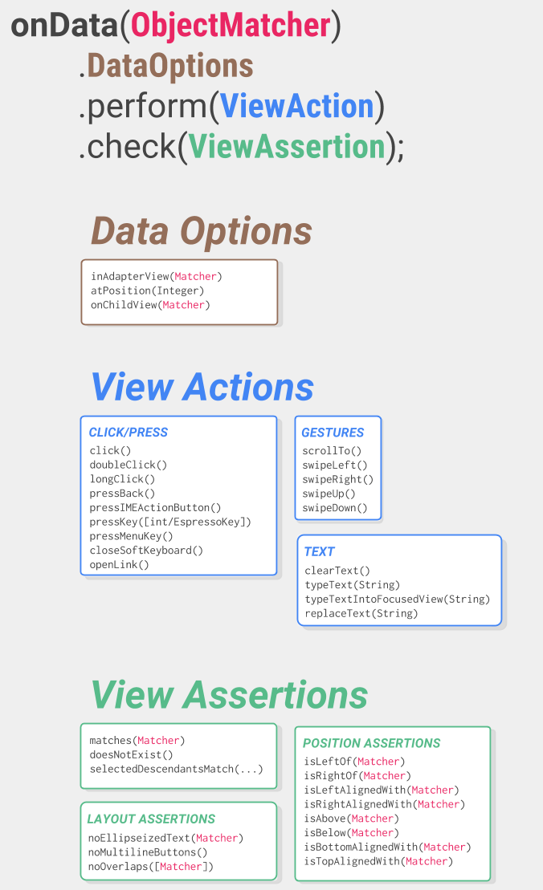
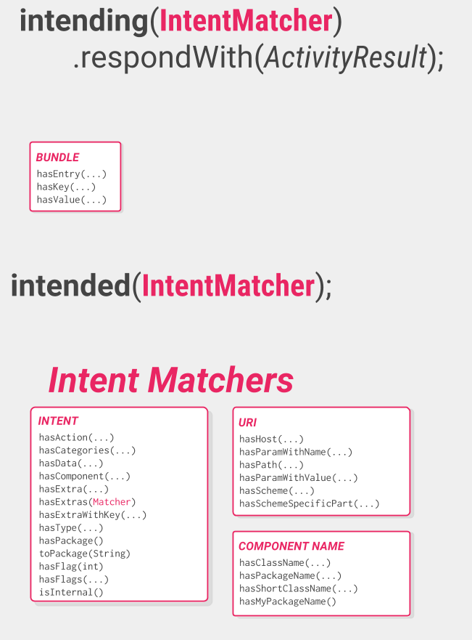
ESPRESSO

Slide 14
QUESTIONS?

Slide 15
Thank you

